Slide 1
Malcolm’s story
By Colin Royle

Slide 2
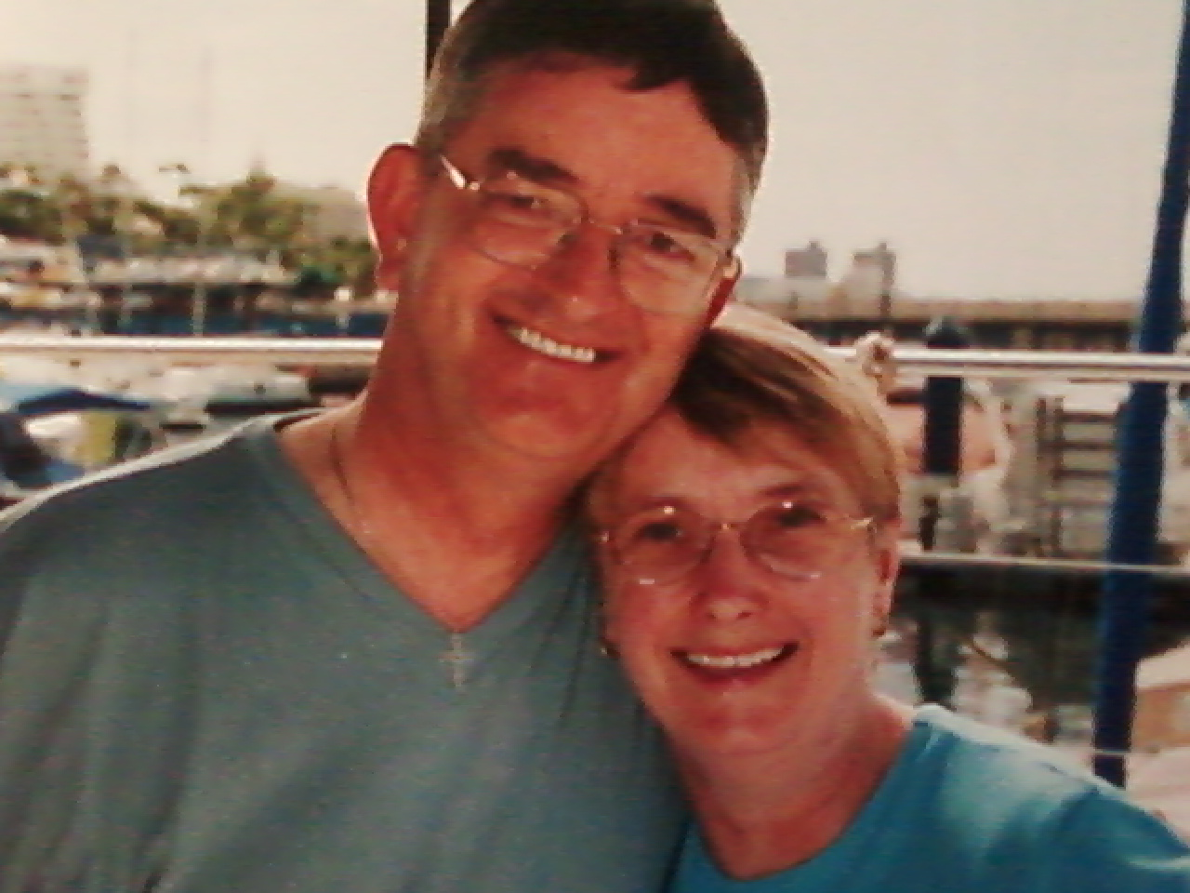

Slide 3
About Malcolm
Celebrated 70th birthday in January last year
Married for over 43 years
Father to two children
Spent most of his career in sales
Retired in 2005 to spend more time with Ann (Malcolm’s wife/my mother)

Slide 4
Becoming Ill - Initial Signs and Symptoms
Withdrawal from activities
Became more self-involved
Some memory loss
Confused and disinhibited

Slide 5
Complex needs
Became doubly incontinent
At high risk of choking (dysphagia)
No longer able to understand what was being said
Unpredictable behaviours and aggression

Slide 6
Diagnosis
Started becoming ill immediately after retiring
Was sectioned (3) in February 2008
Diagnosed with right frontal lobe dementia in June 2008.
Only one in every one million people suffer with this form of dementia

Slide 7
Care Package’s
Discharged from hospital in 2008 under section 117 of mental health act
Fully funded through health
I became Malcolm’s full time carer
Initially attended daycentre Mon – Thurs 8am – 5pm
Started receiving Personal Health Budget in 2009

Slide 8
Importance of getting it right - What helps dementia sufferers
Consistency
Routine
Familiarity
Living at home
Clear and simple language
Appropriate levels of medication

Slide 9
How PHB has been used since 2009
Employed five members of staff to care for Malcolm
We chose rates of pay for carers
Gave choice over attending which daycentre suits him
More flexibility in hours of support
Used for all of Malcolm’s life needs, including health
Purchased sky + box, rented a flat, bought a fence amongst others

Slide 10
Real risk – Money well spent?
Daycentre - £28,500
Didn’t understand his needs
Generic activities
Lack of choice
Lots of anxiety
Highly medicated
Sky + box - £35
Provides choice
Stimulates him
Keeps him calm
Keeps him engaged
Keeps him safe

Slide 11
And finally . . . . . .
Malcolm passed away in April last year
Had consistency in his care until the end
Staff understood his needs and communicated effectively
Medication reduced by 2/3 since getting PHB
Had more choice in activities
Spent all of his life living at home with his family, some six and a half years after being discharged from hospital

